Slide 1

Green Pace
Security Policy Presentation
Developer: Benjamin Abbott

Slide 2

OVERVIEW: DEFENSE IN DEPTH
This security policy will be used to provide consistent approaches and methodologies to implement secure principles to the software development and provide levels of security to Green Pace.

Slide 3
THREATS MATRIX
Likely Threats that are likely to happen. | Priority Threats that need to be handled urgently.
Low priority Threats that can be handled after ones with higher priority | Unlikely Threats that are not likely to happen

Slide 4
10 PRINCIPLES
Validate Input Data – STD-001-CPP, STD-004-CPP
Heed Compiler Warnings
Architect and Design for Security Policies- STD-002-CPP, STD-005-CPP,
STD-006-CPP, STD-007-CPP,
STD-008-CPP, STD-009-CPP,
STD-010-CPP
Keep it Simple- STD-003-CPP,
Default Deny
Adhere to the Principle of Least Privilege
Sanitize Data Sent to Other Systems
Practice Defense in Depth- STD-001-CPP, STD-002-CPP, STD-003-CPP, STD-004-CPP,
STD-005-CPP, STD-006-CPP, STD-007-CPP, STD-008-CPP, STD-009-CPP, STD-010-CPP
Use Effective Quality Assurance Techniques- STD-001-CPP, STD-002-CPP, STD-003-CPP,
STD-004-CPP, STD-005-CPP, STD-006-CPP,
STD-007-CPP, STD-008-CPP, STD-009-CPP,
STD-010-CPP
Adopt a Secure Coding Standard.- STD-001-CPP, STD-002-CPP, STD-003-CPP,
STD-004-CPP, STD-005-CPP, STD-006-CPP,
STD-007-CPP, STD-008-CPP, STD-009-CPP,
STD-010-CPP

Slide 5
CODING STANDARDS
Do not access freed memory
Prevent SQL injection
Do not attempt to modify string literals
Honor exception specifications
Never use assertions to validate method arguments
Allocate sufficient memory for an object
Include the appropriate type information in function declarators.
Do not begin integer constants with 0 when specifying a decimal value
Do not leak memory
Use a static assertion to test the value of a constant expression

Slide 6
ENCRYPTION POLICIES
Encryption in rest refers to data being encrypted while being stored. This data is protected by a key so that only those with the key can access the data. This will help protect data from being accessed by malicious actors or prevent people who do not have proper access from accessing this data.
Encryption at flight refers to data that is encrypted while being transmitted. Before being transmitted this data is encrypted so that those who try to intercept it in transit are unable to access the data. The intended recipient will have the key to the data so that it will be unencrypted when reaching the destination.
Encryption in use refers to data that is encrypted while being used. This is used when security levels are instated, and employees are only granted access to data that is a part of their level of security access.

Slide 7
TRIPLE-A POLICIES
Authentication refers to the process of authenticating the user. This is done by implementing usernames, passwords, as well as two-step verification that adds confirmation emails or texting codes to users to verify identity.
Authorization refers to the level of access that the user has and authorizes the user access to certain data.
Accounting refers to the record keeping of what users do while accessing the system. It records the date, time, user, and what was changed or accessed by them.

Slide 8
Unit Testing
Unit testing is the process of testing the smallest pieces of code that can be isolated in a system and is done during the programming phase.
The following four slides show how unit testing can help detect different vulnerabilities.

Slide 9
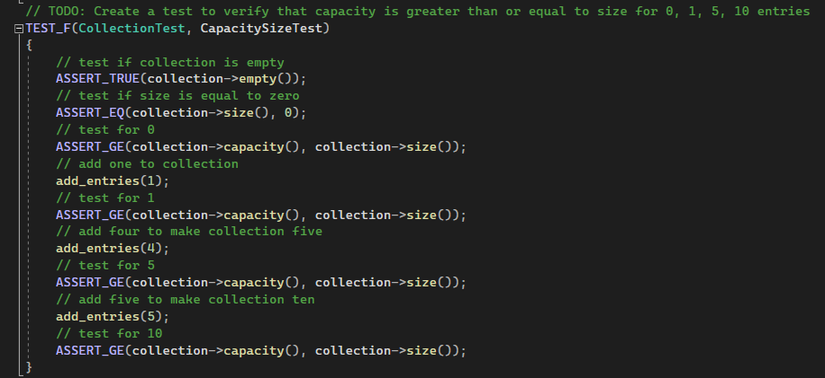
Capacity Unit Test
This is a positive unit test that uses assertions to verify that the capacity is greater than or equal to a variety of vector sizes.
If larger capacity is needed it is important to test for higher capacities before implementing.

Slide 10
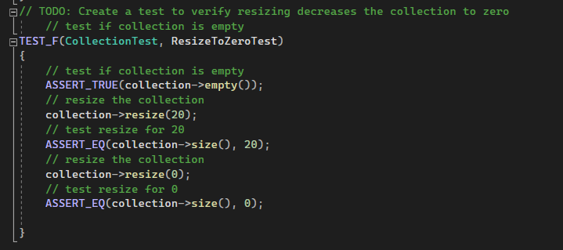
Reset Size to Zero Unit Test
This is a positive unit test that uses assertions to verify that the vector is empty when resizing to zero.
Resizing a vector to zero can be very useful. Don’t use this if you are trying to delete elements. Instead use clear() or erase().

Slide 11
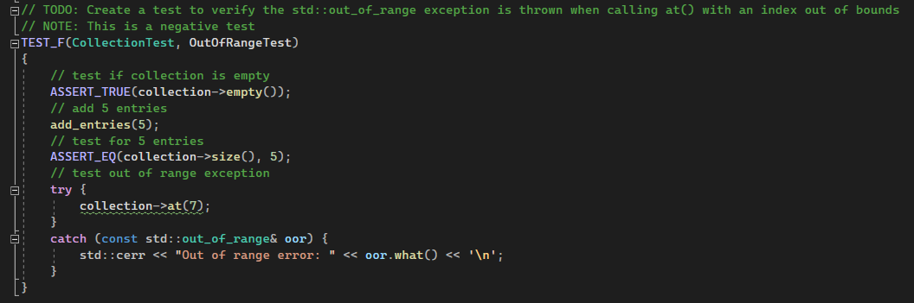
Out of Range Unit Test
This is a negative unit test that verifies that an out of range exception is thrown when calling at() for an element out of bounds.
It might be useful to test the out of range with other functions as well, such as swap() or push_back().

Slide 12
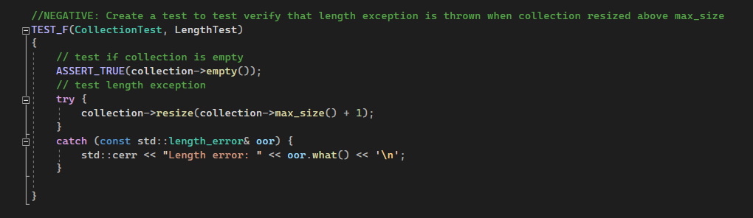
Length Unit Test
This is a negative unit test that verifies that length exception is thrown when a vector is resized over the allowed max size.
It is important to know your boundaries with different classes. Be sure to test other containers if using them.

Slide 13

AUTOMATION SUMMARY

Slide 14
TOOLS
The DevSecOps pipeline is a way to look at the software development lifecycle with the incorporation and prioritization of proper security techniques and protocols.
External tools are used throughout the DevSecOps pipeline to complete tasks such as scanning for vulnerabilities, running analytics, monitoring and detecting events and intrusions, automated response services, and for many other critical needs.

Slide 15
RISKS AND BENEFITS
There are many benefits to following the DevSecOps pipeline and developing with security in mind. It will not only help both developers save time and companies save money, but it will also aid in producing more secure code.
Benefits include:
Saving time and money (in the long run)
Produce more secure code
Testers have more time for critical tests on features and finding vulnerabilities

Slide 16
RECOMMENDATIONS
Create standards for future development.
Develop with DevSecOps pipeline.
Use encryption for all data in flight, at rest, and in use.
Use the Triple-A framework strategy
Use unit testing
Use external tools

Slide 17
CONCLUSIONS
While it is true that there is no such thing as 100% secure code. It is vital to ensure that you have developed the most secure code that you can. Implementing Defense in Depth and using the DevSecOps pipeline along with adopting the standards and tools discussed today during development, will not only improve the security of the systems that will be developed, but it will also lead to consistency and ensure that only the highest quality of software is produced at Green Pace.

